Slide 1
Digital Portfolio
STUDENT UDENT NAME: LIVISTAN. P
REGISTER NO AND NMID: F88F6AF069A5F9FBE5C4E05A8FB69528
DEPARTMENT: BSC computer science
COLLEGE: COLLEGE/ UNIVERSITY :Siddhartha sivagnaani arts and
science college,affiliated to Annamalai university

Slide 2
Digital Student Portfolio

Slide 3


AGENDA
Problem Statement
Project Overview
End Users
Tools and Technologies
Portfolio design and Layout
Features and Functionality
Results and Screenshots
Conclusion
Github Link
3/21/2024 Annual Review

Slide 4

PROBLEM STATEMENT
In the current digital era, students mostly rely on paper resumes to present their skills and achievements. This creates a limitation, as resumes are static and cannot fully highlight their projects, talents, or creativity. Employers and academic evaluators prefer a more interactive and professional medium to understand a student’s profile. To overcome this issue, a personal portfolio website can be developed, which provides an online platform for students to showcase their academic details, technical skills, and project work in an attractive and accessible way.

Slide 5

PROJECT OVERVIEW
This project is a Student Portfolio Website developed using HTML, CSS, and JavaScript. The main purpose of the project is to provide students with an online platform to showcase their personal details, academic qualifications, technical skills, and project work in an attractive and professional way. Unlike paper resumes, a portfolio website is interactive, accessible from anywhere, and helps students present their profile more effectively.The website consists of different sections such as About Me, Skills, Projects, and Contact Form. The HTML part is used to design the structure, CSS is used for styling and layout, and JavaScript is used to add interactivity like form validation and alerts. This project demonstrates the fundamentals of web development and gives students a real-time experience of creating and hosting a website on platforms like gitHub pages

Slide 6

WHO ARE THE END USERS?
1.Students (to showcase their profile)
2.Recruiters / Employers (to view skills & hire)
3.College Faculties (to evaluate students)
4.Peers & Public (to know about students work)

Slide 7

TOOLS AND TECHNIQUES
HTML5 – Structure of the website
2.CSS3 – Styling and layout
3.JavaScript – Interactivity and validation
4.Vs Code / Notepad++ – Code editor
5.Web Browser (Chrome) – Testing the website
6.GitHub – Hosting and version control

Slide 8
PORTFOLIO DESIGN AND LAYOUT
Header → Website name + navigation links
About → Small intro about me.
Skills → My technical abilities.
Project → List of works I have done.(HTML,CSS,JAVASCRIPT)
Contact → Simple form to reach me(email)
Footer → Copyright note
“My portfolio layout has header, about, skills, projects, contact, and footer sections” .
8

Slide 9
FEATURES AND FUNCTIONALITY
User-Friendly Design → The website is simple and clean, so anyone can easily navigate.
Header & Navigation → Provides quick links to each section like About, Skills, Projects, and Contact.
About Section → Gives a short introduction of the student.
Skills Section → Highlights technical abilities such as HTML, CSS, JavaScript, etc
Projects Section → Displays the list of projects completed by the student.
Contact Form → Allows visitors to send their details (name, email, message).
JavaScript Functionality → Validates the contact form and gives a success mmessage.
Footer → Shows copyright note at the bottom of the page

Slide 10
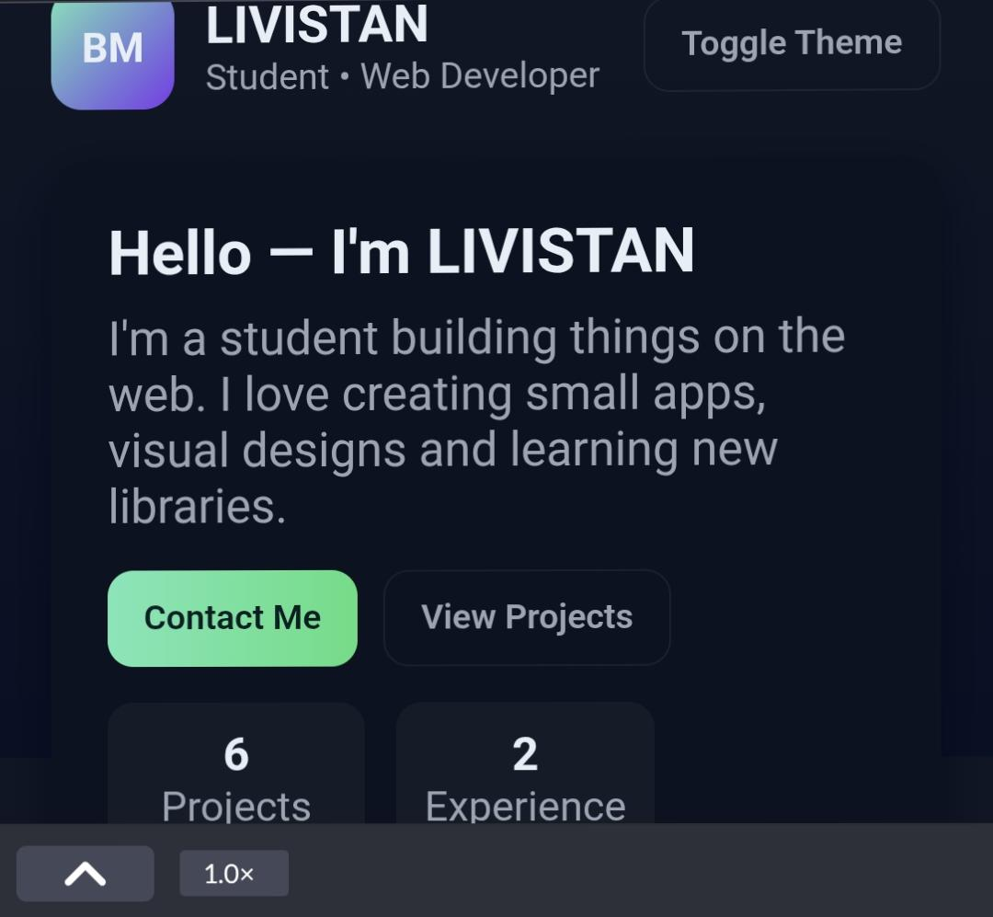

RESULTS AND SCREENSHOTS
3/21/2024 Annual Review
10

Slide 11
CONCLUSION
The Student Portfolio Website provides an effective online platform for students to present their personal details, skills, and projects in a professional way. Unlike traditional paper resumes, this website is interactive, easy to access, and visually appealing. It is developed using the fundamentals of web development — HTML for structure, CSS for design, and JavaScript for interactivity. The project not only helps students showcase their profile to recruiters and faculty but also improves their practical knowledge in creating and hosting websites. Overall, this project demonstrates the importance of web technologies in building a personal brand and enhancing career opportunities.
11

